Slide 1

Olympics History Project
SALONI Reddy
This Photo by Unknown Author is licensed under CC BY-SA

Slide 2
Introduction
This project aims to explore the history of the Olympics using SQL (Structured Query Language), a powerful tool for managing and analyzing large datasets

Slide 3
DATA SOURCE
The dataset used in this project includes historical data of the Olympic games , encompassing details about:
Athletes: Names , genders and the countries they represent.
Events: Types of sports and specific events
Medals: Gold, Silver and bronze medalists across different games
Olympic games: Years, locations, and participating nations

Slide 4
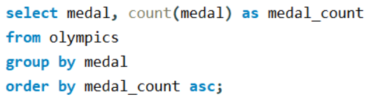
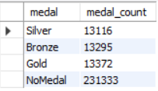
Q1. Show how many medal counts present for entire data.

Slide 5


Q2. Show count of unique Sports are present in Olympics.

Slide 6
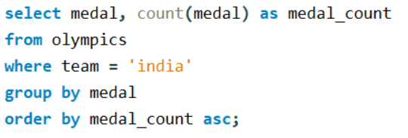
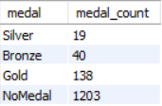
Q3. Show how many different medals won by Team India in data.

Slide 7
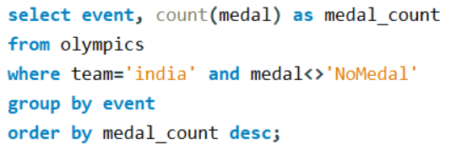
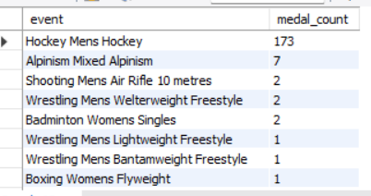
Q4. Show event wise medals won by India show from highest to lowest medals won in order.

Slide 8
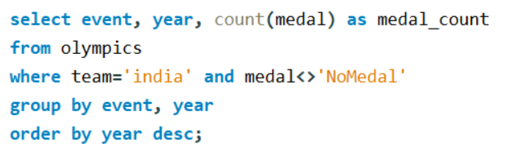
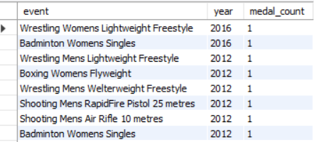
Q5. Show event and year wise medals won by India in order of year.

Slide 9
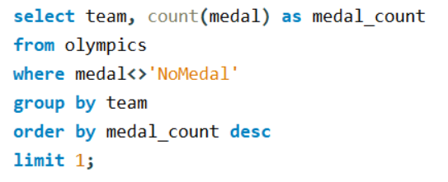

Q6. Show the country with maximum medals won gold, silver, bronze

Slide 10
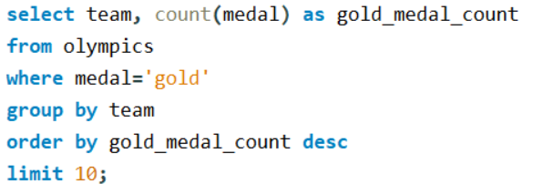
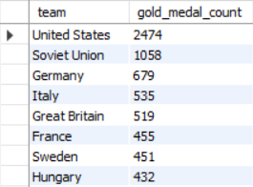
Q7. Show the top 10 countries with respect to gold medals

Slide 11
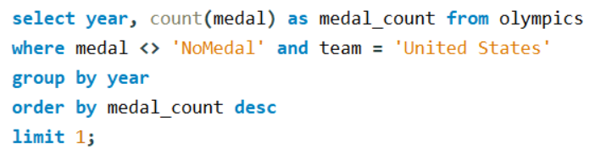

Q8. Show in which year did United States won most medals

Slide 12
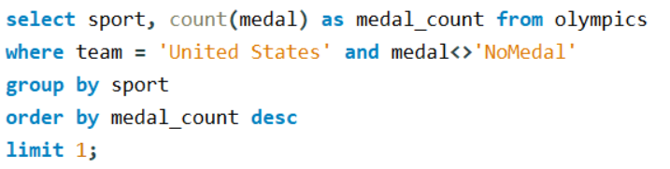

Q9. In which sports United States has most medals

Slide 13
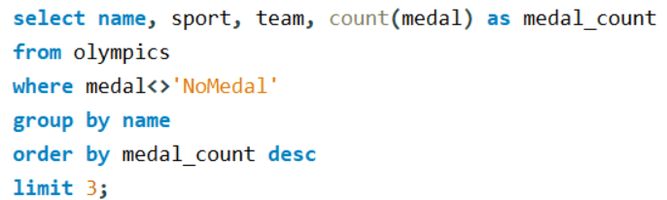
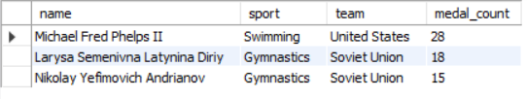
Q10. Find top 3 players who have won most medals along with their sports and country.

Slide 14
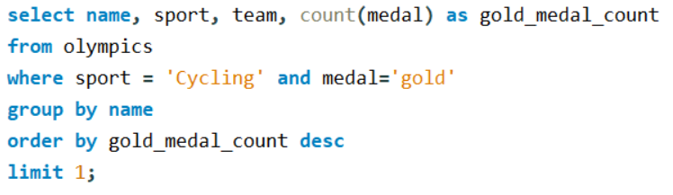

Q11. Find player with most gold medals in cycling along with his country.

Slide 15
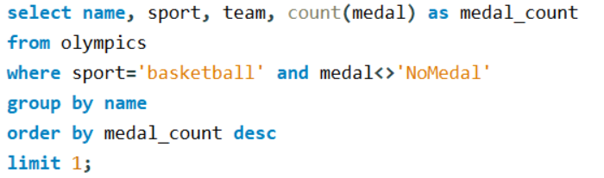

Q12. Find player with most medals (Gold + Silver + Bronze) in Basketball also show his country.

Slide 16
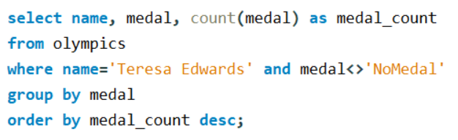

Q13. Find out the count of different medals of the top basketball player.

Slide 17
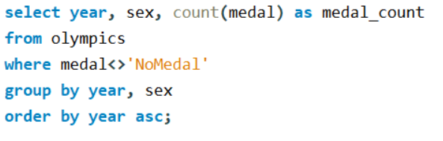
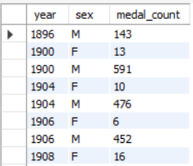
Q14. Find out medals won by male, female each year

Slide 18
Q14. Graph for male vs female medals

Slide 19
Thank you

